Slide 1

Verona – IRIS-MMX
Jan, 2025

Slide 2
Agenda
xx
xx
xx
xx
xx

Slide 3



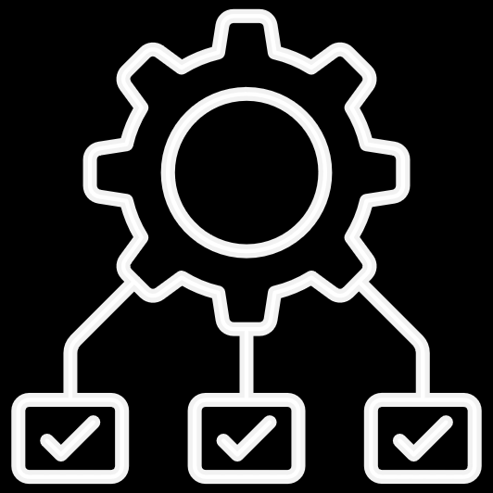
DVC Overview
Overview
Main Use Cases
Special Characteristics
Requisites
Open source
Basically, to track and save Large Datasets/files and model
To make the DS projects/experiments reproducible
Limitations of Git:
Code version tracking and maintenance can be done
thru Git.
But Git cannot hold numerous versions of the datasets (large datasets) and various ML models which occupies more space.
Data Management
ML pipeline Management
Experiment Management
Model Registry
Works on top of GIT Repo
Platform Agnostic – All OS, All Progamming languages, All ML libraries
Existing Software Resources can be leveraged – Compute, Cloud or On Prem, Storage etc
Any On Prem storage or Cloud Storage which can be sufficient for storing the datasets/file versions (preferably a hug
storage area)
Git

Slide 4
DS team
MMX team
Data processing
Model Building
Source
Verona Snowflake (Client Environment)
IRIS
(Workflows)
IRIS- Databricks Intermediate tables (Transformed/
Processed Data)
ML Model
MMX Studio
Visual O/P from MMX

Slide 5



Overall Process
Git will have the only the Config files which has the reference to the actual version present in the Remote storage
DVC framework will ensure the versions are maintained in the Remote Storage
Any type of file can be maintained using DVC framework (Data files, Models etc)
Key
Storage
Remote Storage can be Cloud or On- Prem
Remote Storage will have the actual multiple versions of the file.
Git Init, DVC Init are two main commands to initiate the DVC connectivity.
Followed by DVC remote to connect to the remote storage
Whenever there is a new file being processed in the Directory, the latest version will be pushed (DVC push + add ) to the Remote Storage and the same time, Git will be updated with latest version references with version number being
tagged properly.
Whenever the user wants to retrieve a particular version, Git pull commands will ensure the respective version is pulled from the storage thru DVC
Process

Slide 6
Fitment to IRIS
Under the Model workflow/Visual Workflow
Use Case
Data File Version 1 & Model Version 1
Data File Version 2 & Model Version 2
User creates a workflow with some transformation rules for a particular data source
When the user runs the created workflow and the target data can be a resultant data file (Preferably CSV – assume that this is a huge file which can’t accommodated in Git)
This resultant CSV file can be pushed through DVC using GIT and stored in the remote location (mostly a Cloud storage) and kept as csv.v1 Version 1
With this transformed file, the user runs the ML model1 and perform the scoring for the model1
To improve the efficiency of the model, the same user does more transformation rules to the same source data and executes the workflow. The resultant file data file is the second version.
This resultant CSV file from the second execution can be pushed again through DVC using GIT and stored in the same remote location (mostly a Cloud storage) and kept as csv.v2 Version 2
With this transformed file, the user runs the ML model2 and perform the scoring for the model2
Helps in Reproducibility of ML Models:
On seeing the Output of the two Models the User feels Model1 is better than Model2, hence the user wants to use the transformed resultant file csv.v1 to achieve the Model1
Using Git thru DVC, the user can pull the respective version CSV v1 and reproduce the Model1

Slide 7
High level
Overall flow
Storage - Remote
Cloud/On prem)
Dvc remote add remote name and url path
Database
Data
DVC add + Push Data CSV V1
V1.0 Data CSV
Actual Data File with different versions
Cloud/On Prem Storage
DVC add + Push Data CSV V2
V2.0 Data CSV
Directory
Git
DVC
Git Pull
Data Transformations
Config files (Git Config files will have the references to the actual versions of the files)
Data Transformations
Config/Metadata files
Git
Git Push
Git Commands :
The following Git commands should be executed to tag the latest version of the file
Git add, commit, tag, push
1st run
Data CSV V1.0
2nd run
Data CSV V2.0
Model V1
Model V2

